Slide 1

Evening services – 6:30pm Sun – Wed
MBT breakfast time – 7:45am Mon-Wed

Slide 2
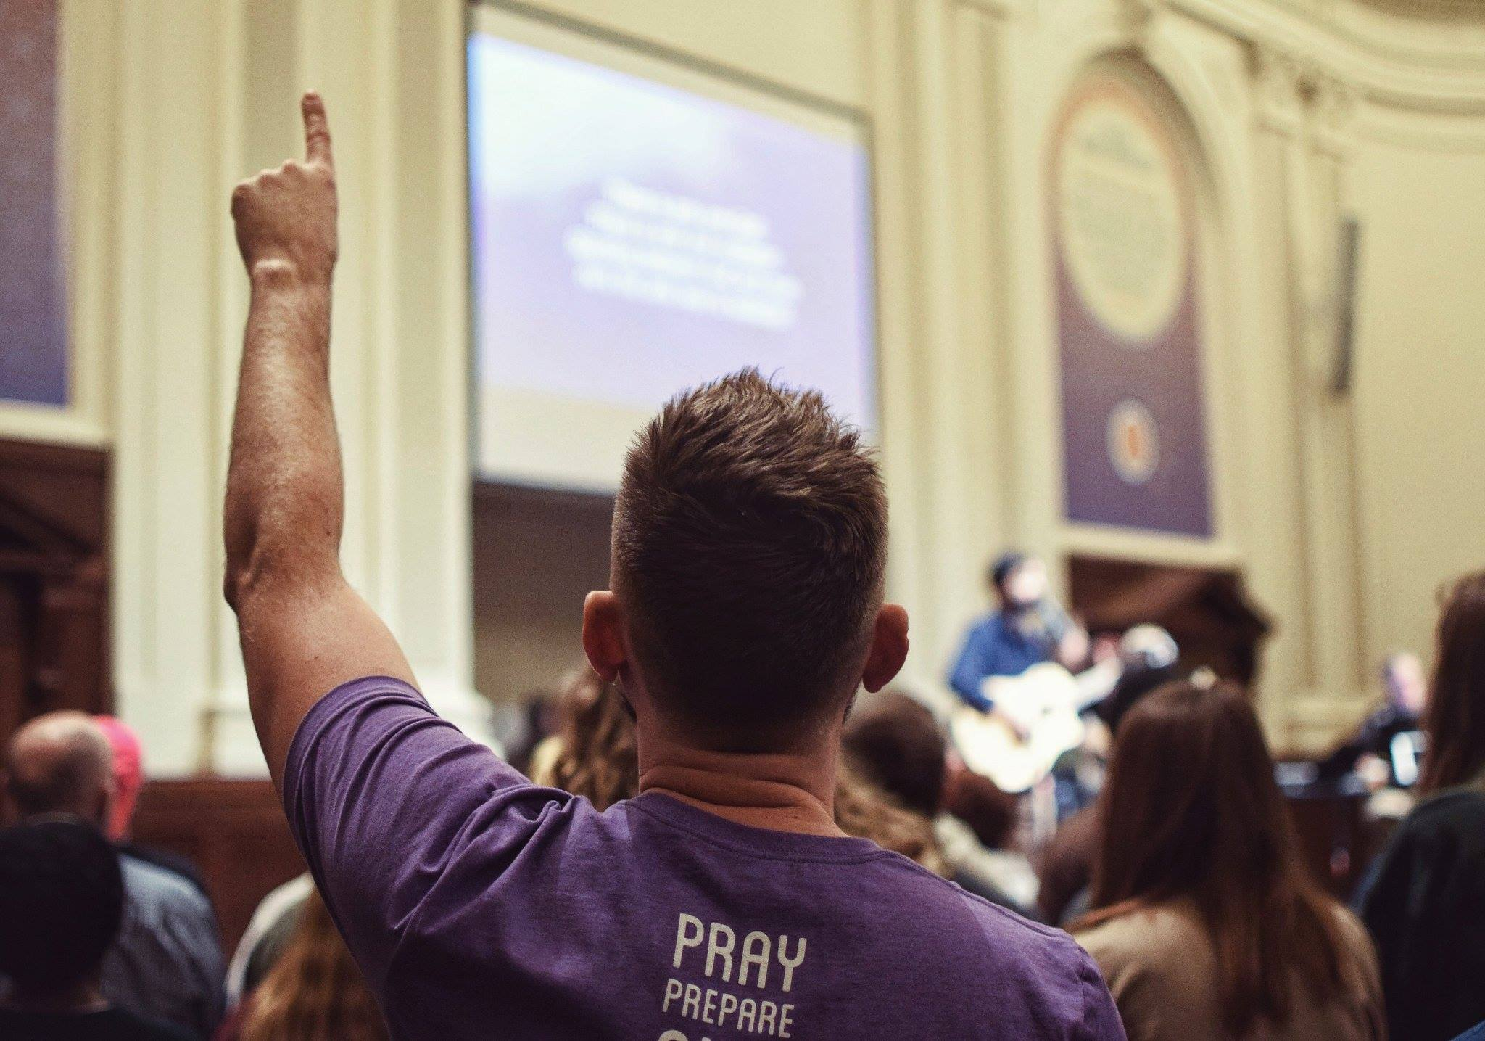
0
Vision
Update
2
8
1
Focus Prep

Slide 3
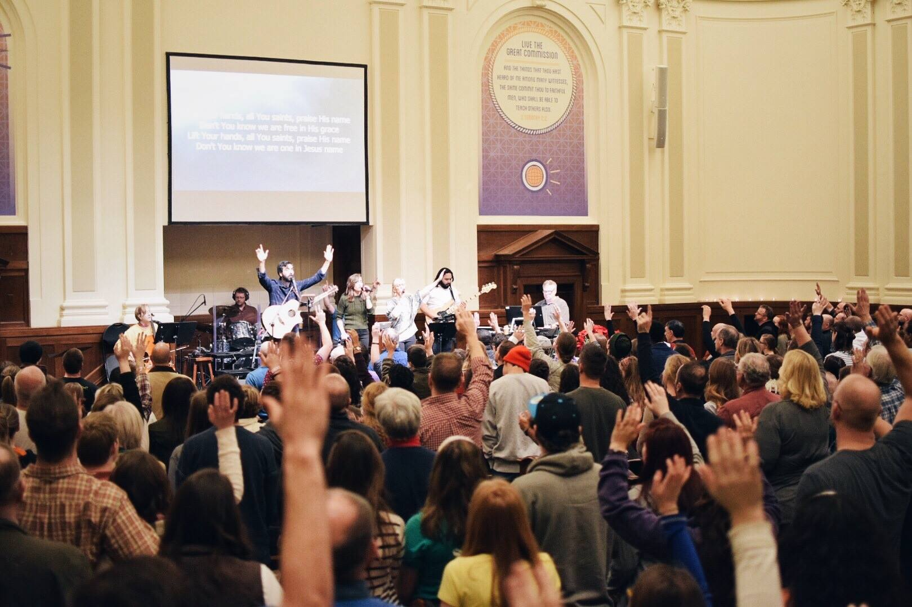

Our purpose: to know God, to love Him and to glorify God here at home and throughout the whole earth.
That takes a FUNCTIONAL discipleship ministry.

Slide 4
dysfunction
When not the Word of God, but the opinions of men rule in the life of the church.
Judges 21:25 In those days there was no king in Israel: every man did that which was right in his own eyes.
Proverbs 12:15 The way of a fool is right in his own eyes: but he that hearkeneth unto counsel is wise.
Psalm 14:1-3 The fool hath said in his heart, There is no God. They are corrupt, they have done abominable works, there is none that doeth good. ² The LORD looked down from heaven upon the children of men, to see if there were any that did understand, and seek God. ³ They are all gone aside, they are all together become filthy: there is none that doeth good, no, not one.

Slide 5
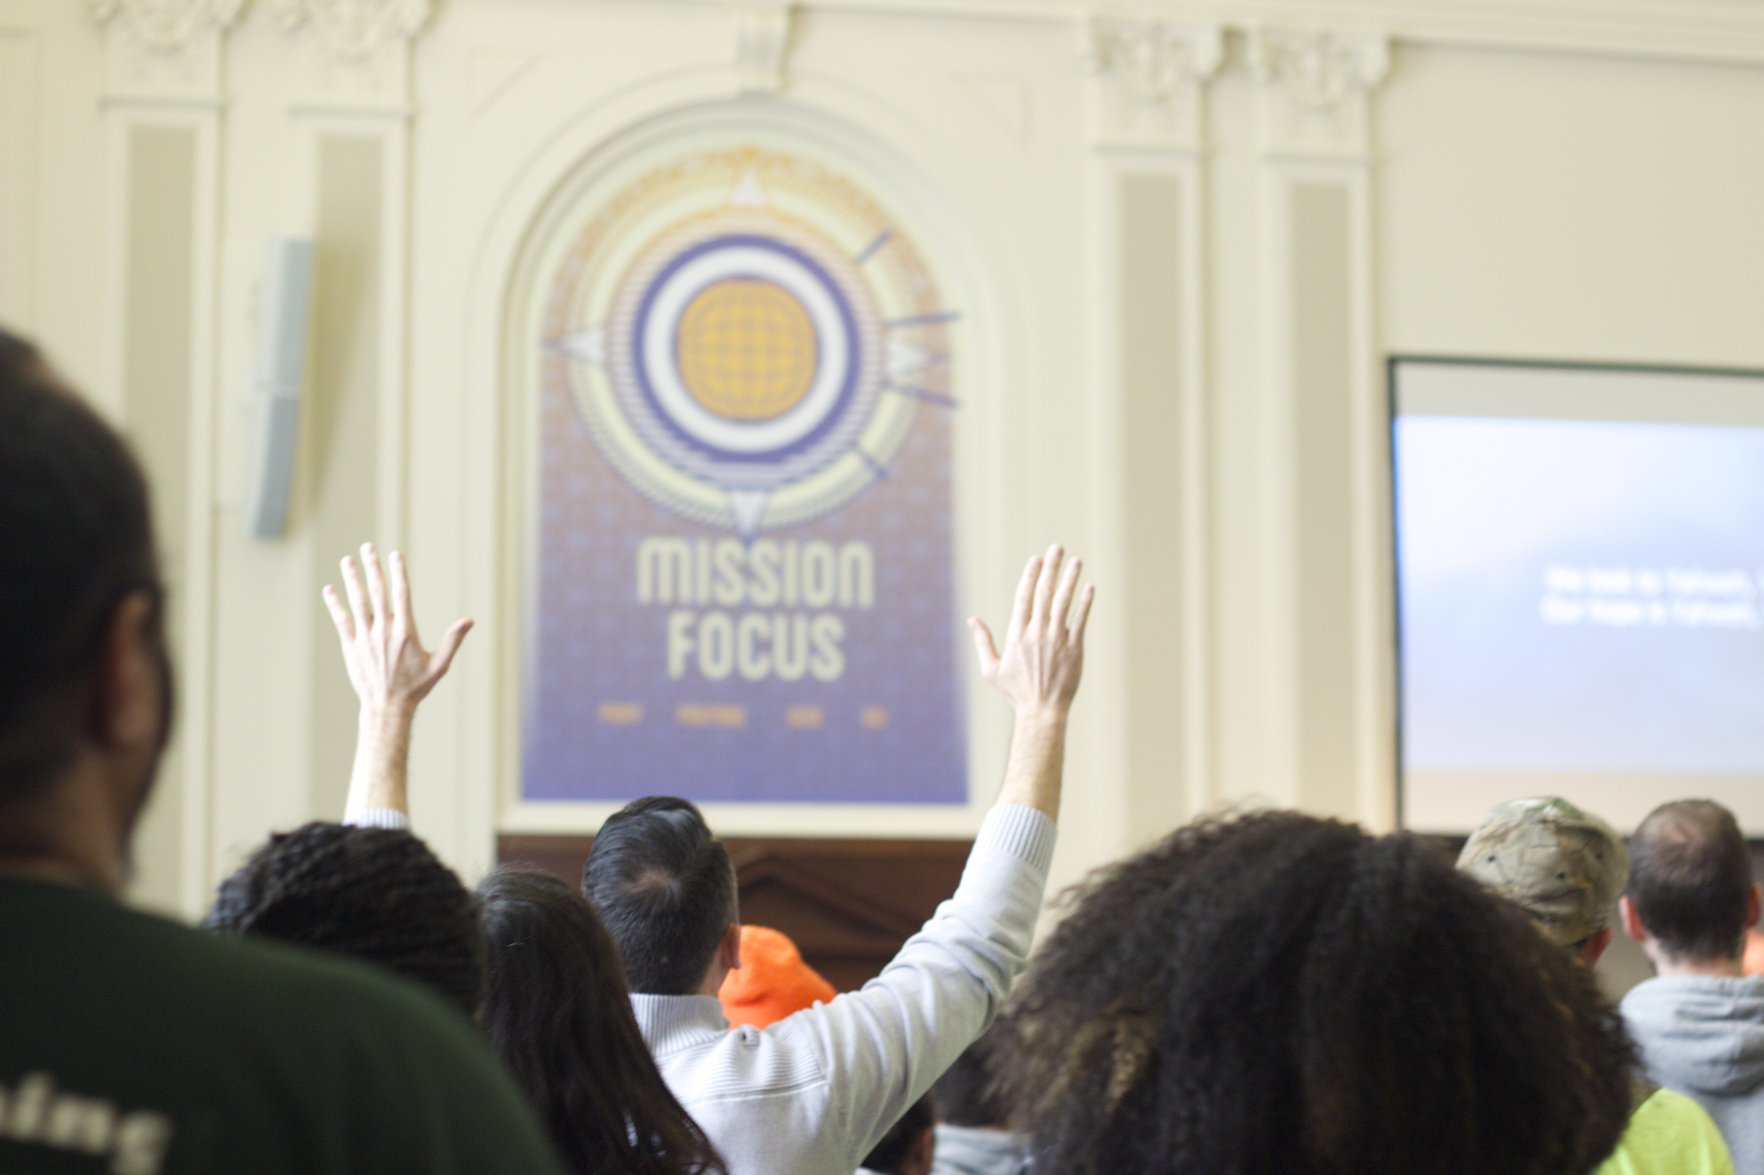
Doubling Down on discipleship
We must get our relationship with and response to the LORD right!
Matthew 22:37 Jesus said unto him,
Thou shalt love the Lord thy God with
all thy heart, and with all thy soul, and with all thy mind.

Slide 6
OUR mission:
Multiplication thru evangelism and discipleship.
Genesis 1:27-28 So God created man in his own image, in the image of God created he him; male and female created he them. ²⁸ And God blessed them, and God said unto them, Be fruitful, and multiply, and replenish the earth, and subdue it: and have dominion over the fish of the sea, and over the fowl of the air, and over every living thing that moveth upon the earth.
Matthew 28:18-20 And Jesus came and spake unto them, saying, All power is given unto me in heaven and in earth. ¹⁹ Go ye therefore, and teach all nations, baptizing them in the name of the Father, and of the Son, and of the Holy Ghost: ²⁰ Teaching them to observe all things whatsoever I have commanded you: and, lo, I am with you alway, even unto the end of the world. Amen.

Slide 7
OUR mission:
Our mission requires spiritual reproduction.
Because our INFINITE King requires an INFINITELY EXPANDING kingdom.
Isaiah 9:6-7 For unto us a child is born, unto us a son is given: and the government shall be upon his shoulder: and his name shall be called Wonderful, Counsellor, The mighty God, The everlasting Father, The Prince of Peace. ⁷ Of the increase of his government and peace there shall be no end, upon the throne of David, and upon his kingdom, to order it, and to establish it with judgment and with justice from henceforth even for ever. The zeal of the LORD of hosts will perform this.

Slide 8
OUR mission:
Our mission requires spiritual reproduction.
Because our INFINITE King requires an INFINITELY EXPANDING kingdom.
Matthew 25:25-26 And I was afraid, and went and hid thy talent in the earth: lo, there thou hast that is thine. ²⁶ His lord answered and said unto him, Thou wicked and slothful servant, thou knewest that I reap where I sowed not, and gather where I have not strawed:

Slide 9
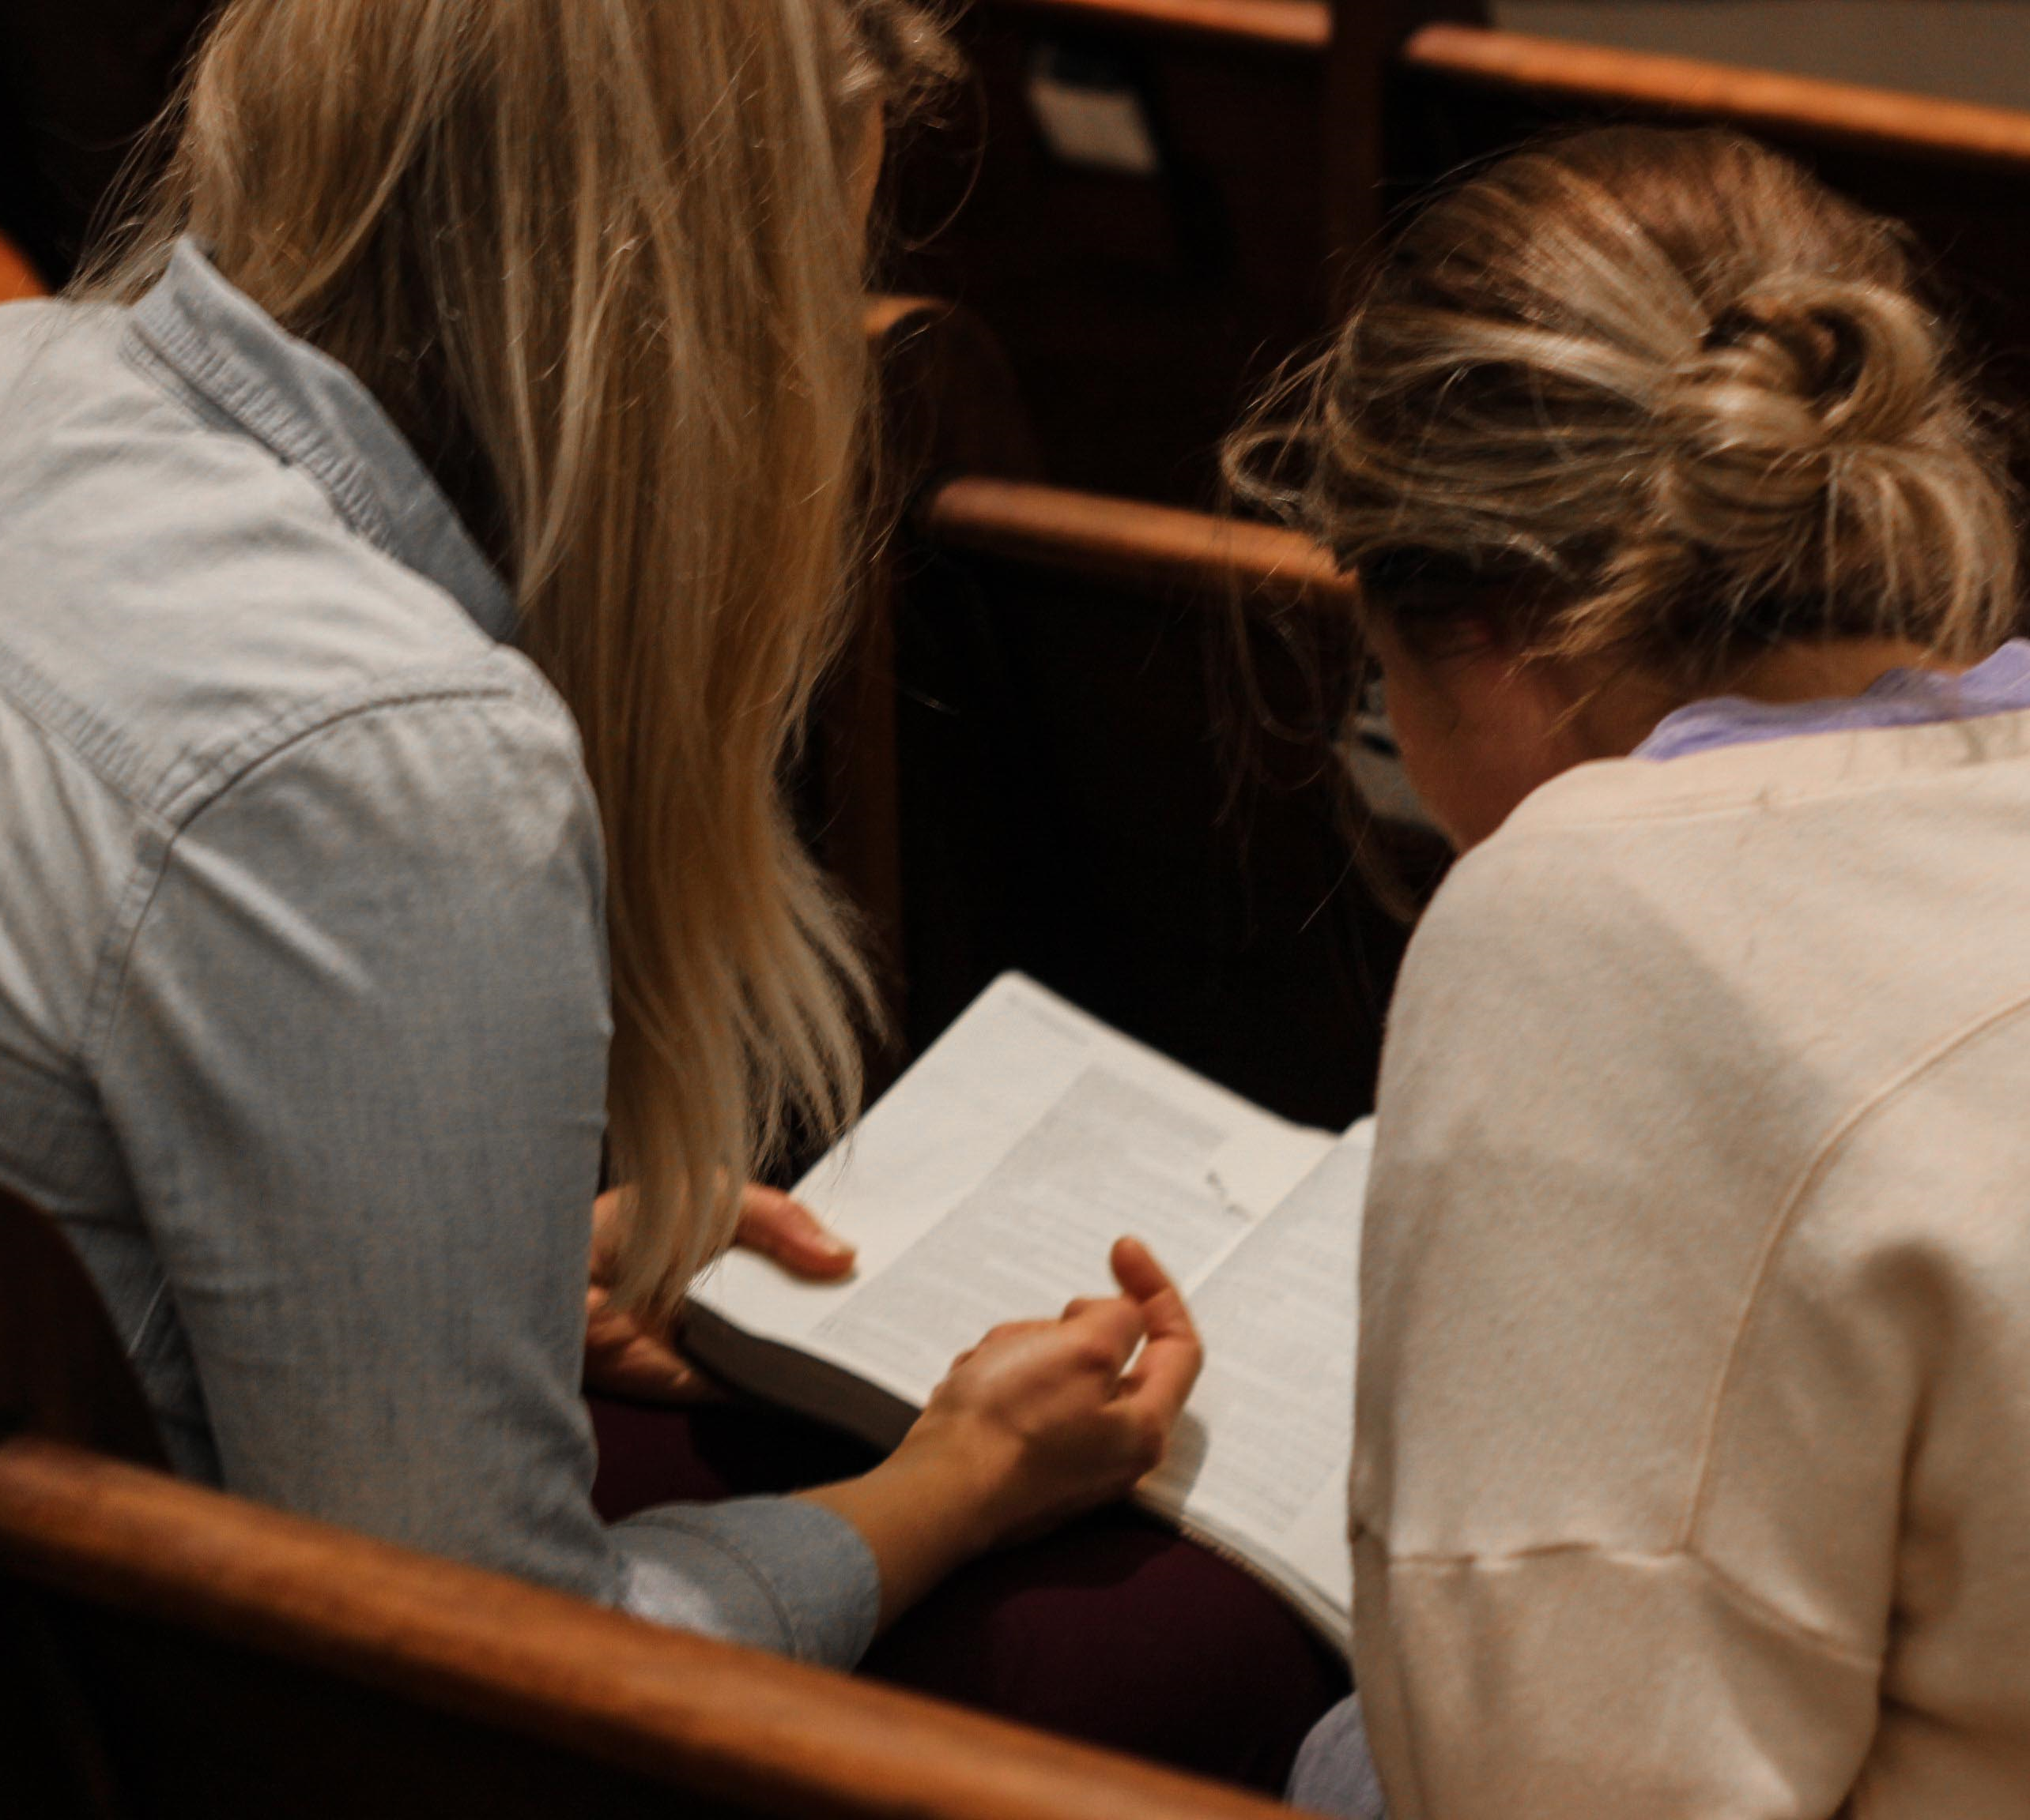
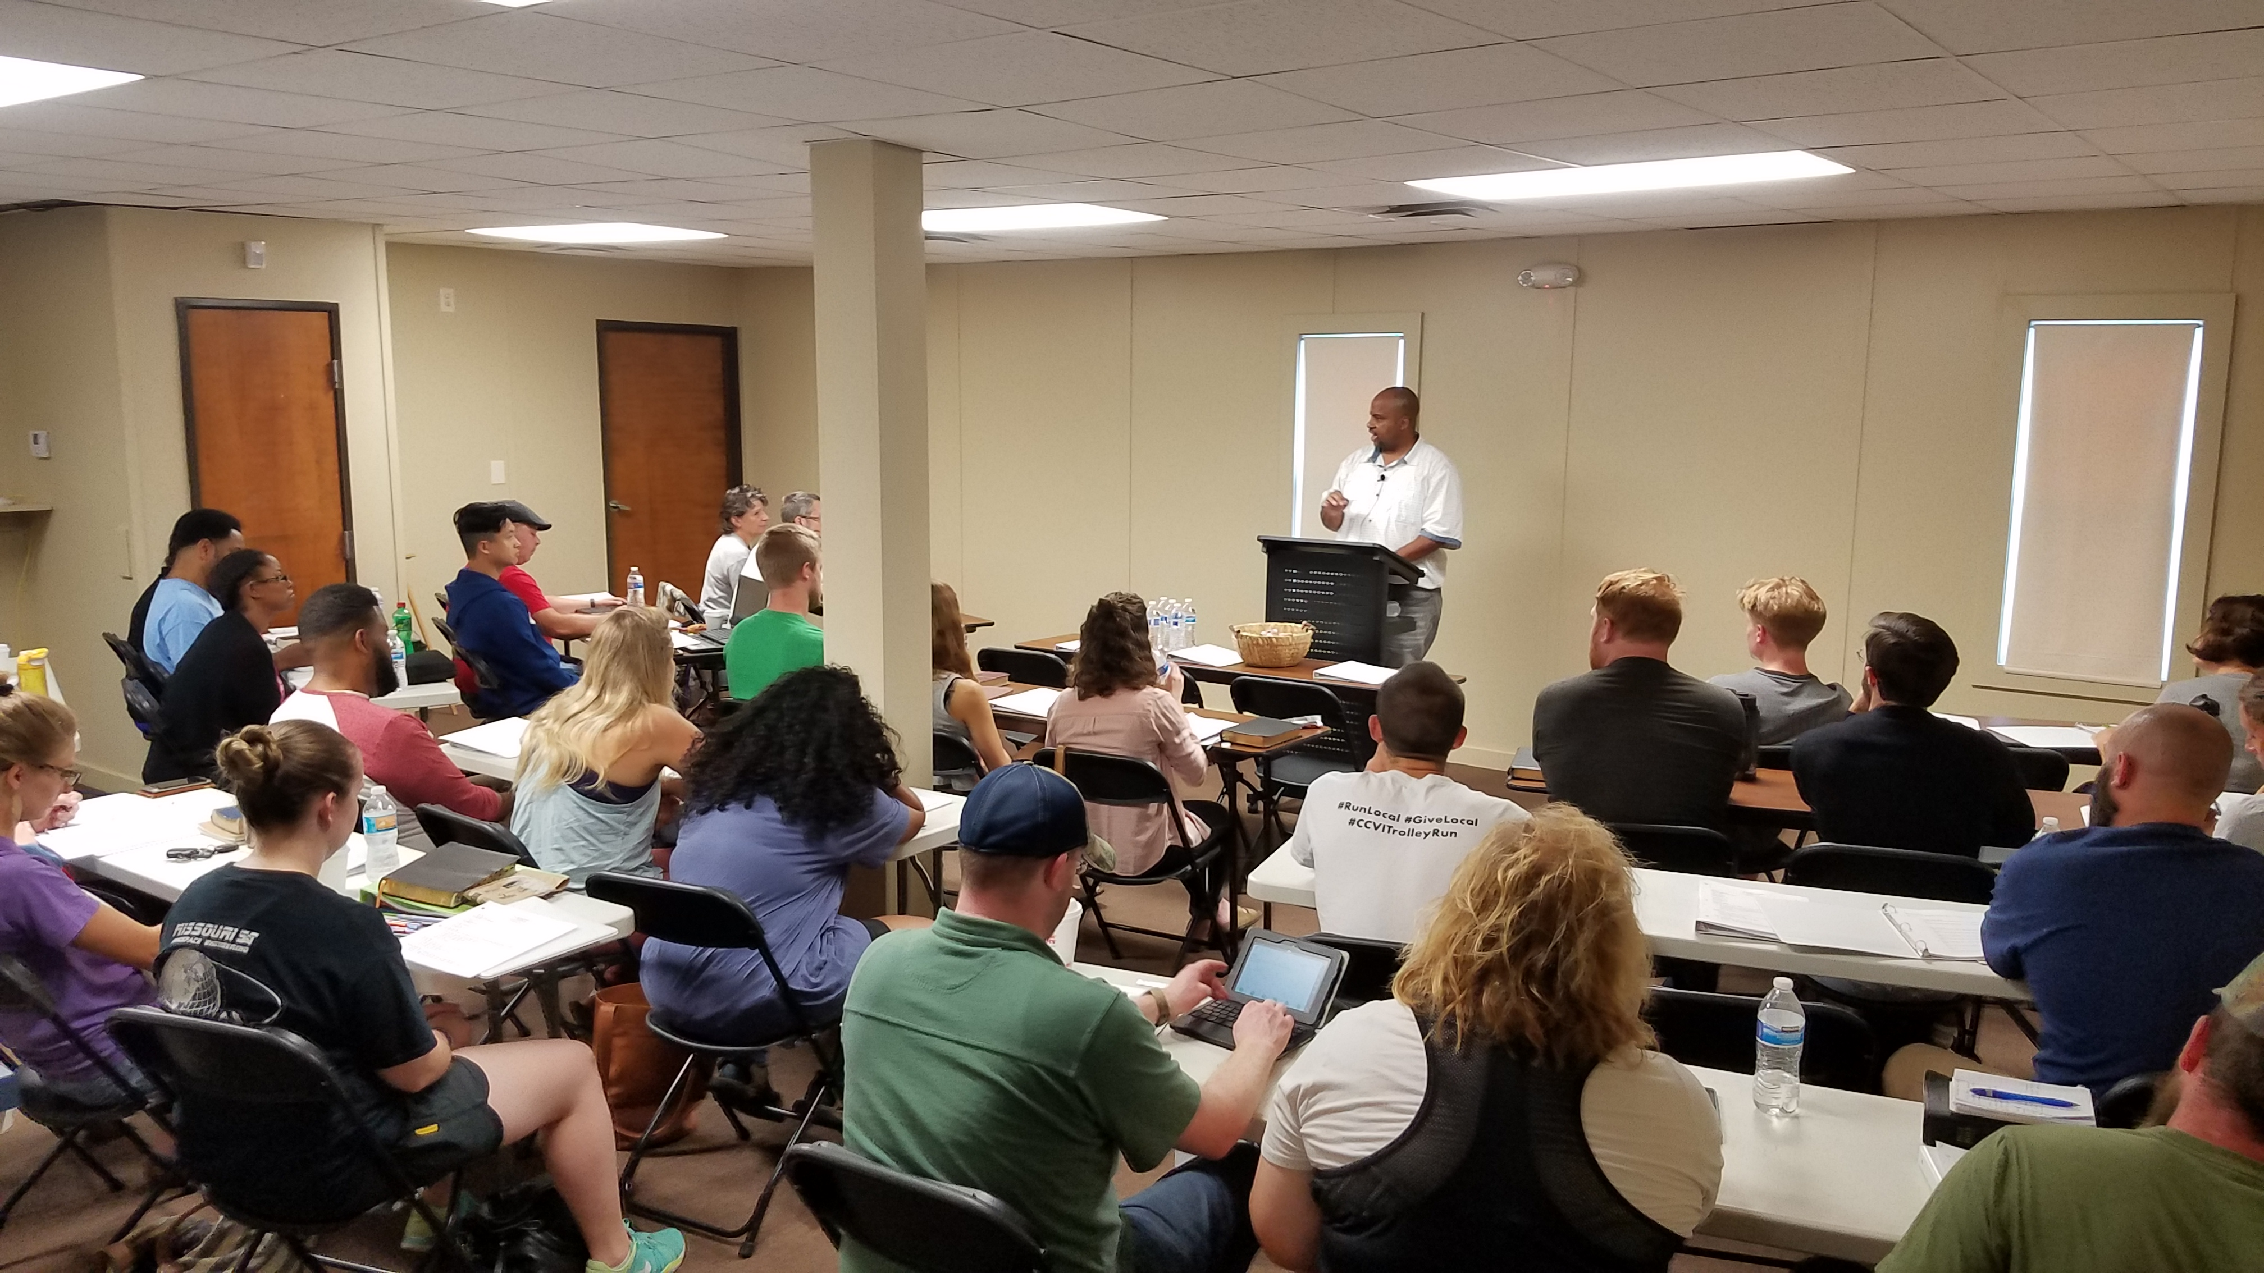
God has given us His LIFE and His WORD.
We must multiply that INVESTMENT thru evangelism and discipleship .
KEY: Mold and mobilize each member. Every member a MINISTER. EQUIPPED.
BUT: Every minister must also be a MEMBER!

Slide 10
OUR mission
Ephesians 4:11-16 And he gave some, apostles; and some, prophets; and some, evangelists; and some, pastors and teachers; ¹² For the perfecting of the saints, for the work of the ministry, for the edifying of the body of Christ: ¹³ Till we all come in the unity of the faith, and of the knowledge of the Son of God, unto a perfect man, unto the measure of the stature of the fulness of Christ: ¹⁴ That we henceforth be no more children, tossed to and fro, and carried about with every wind of doctrine, by the sleight of men, and cunning craftiness, whereby they lie in wait to deceive; ¹⁵ But speaking the truth in love, may grow up into him in all things, which is the head, even Christ: ¹⁶ From whom the whole body fitly joined together and compacted by that which every joint supplieth, according to the effectual working in the measure of every part, maketh increase of the body unto the edifying of itself in love.

Slide 11

If you’re trying to operate OUTSIDE of the way God made you, you’ll just be frustrated.

Slide 12

1 Cor 12; Rom 12 –
How has God gifted you?
Faith
Wisdom / Discernment
Ministry / Helps
Teaching
Exhortation
Giving
Ruling
Mercy
Do what God has DESIGNED you to do! That is not easy, it’s HARD.
Satan is working to keep you out.

Slide 13
LOVE
Ephesians 4:30-32 And grieve not the holy Spirit of God, whereby ye are sealed unto the day of redemption. ³¹ Let all bitterness, and wrath, and anger, and clamour, and evil speaking, be put away from you, with all malice: ³² And be ye kind one to another, tenderhearted, forgiving one another, even as God for Christ's sake hath forgiven you.

Slide 14
2018 Missions trips
109
Went on
12 trips

Slide 15
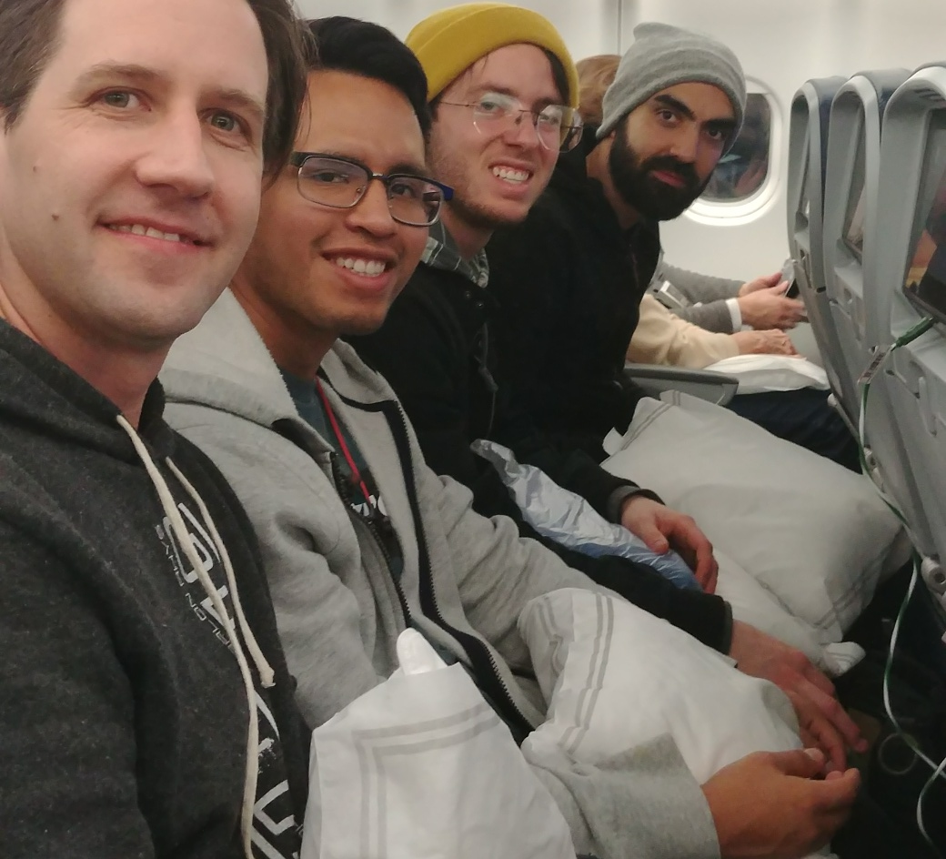
2018 India Mission Trip Team
Dan Reneau
Chris Best
Brian Bustos
Alvaro Briones
Seth Harper

Slide 16
2018 India Mission Trip
3 pastor conferences in 3 locations with 2 different ministries.
Seth and /Alvaro worked with youth and gave testimonies and other things.
Travel was intense: >30 hours to get there, > 20 hrs travel on Saturday, 48 hrs travel home.
Busy Trip. For example, Chris taught/preached 15 times in 7 locations in 10 days. (9 conference sessions, 2 Sunday AM church services, one Sunday night service, 2 Bible studies, 1 Christmas service)

Slide 17
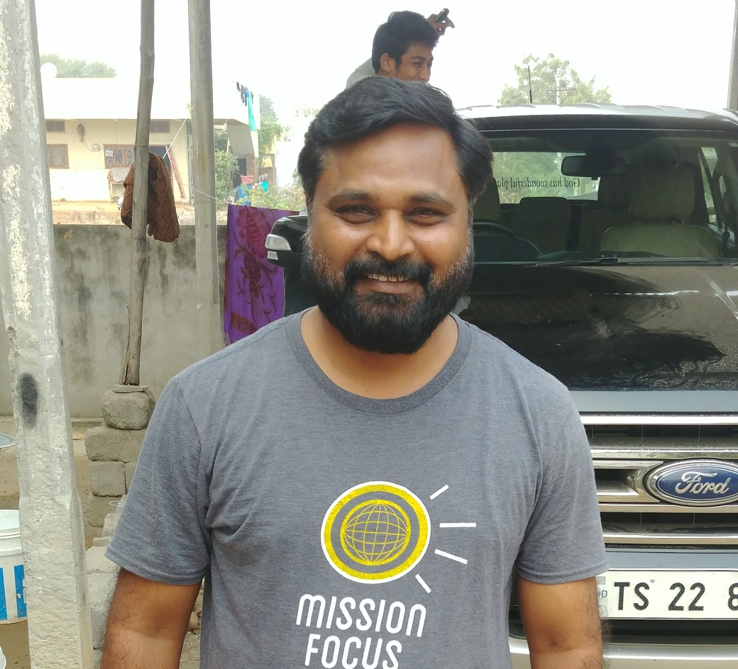
Christudas Erla
Director of Good News to All People (G.A.P.) http://www.gap-ministries.org
Pedipally India, near Hyderabad

Slide 18
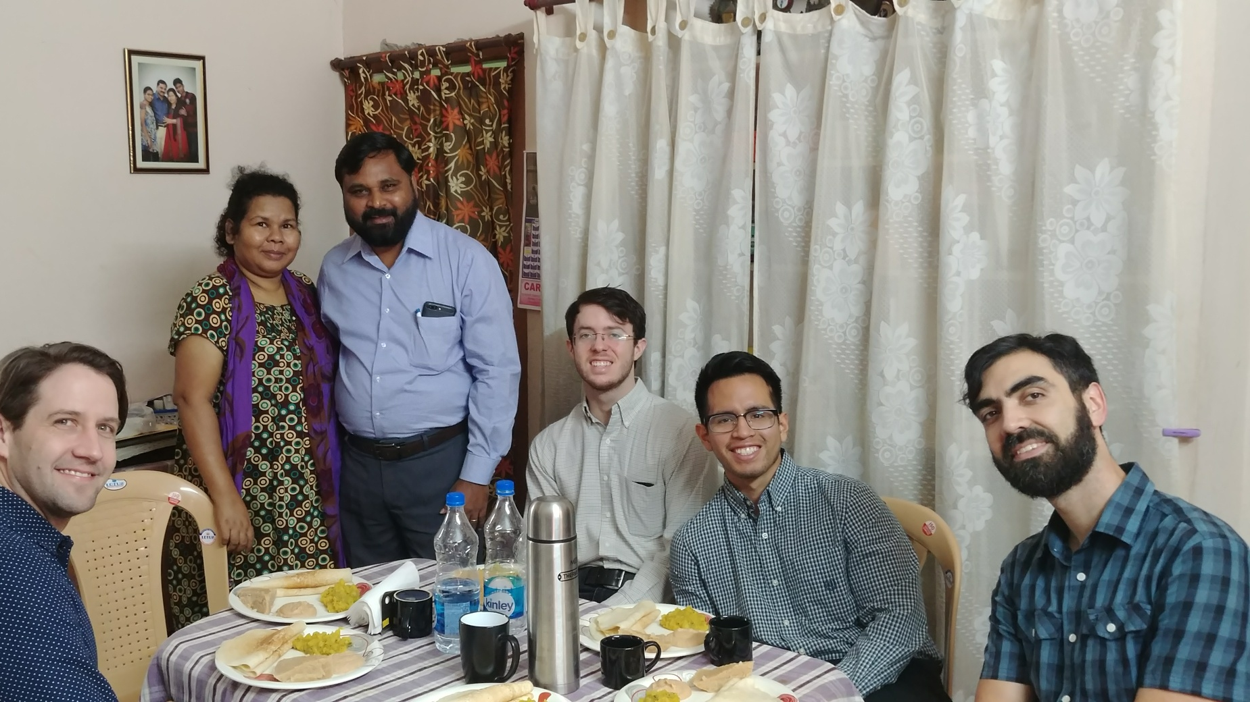
At Christudas’ House in Pedipally

Slide 19
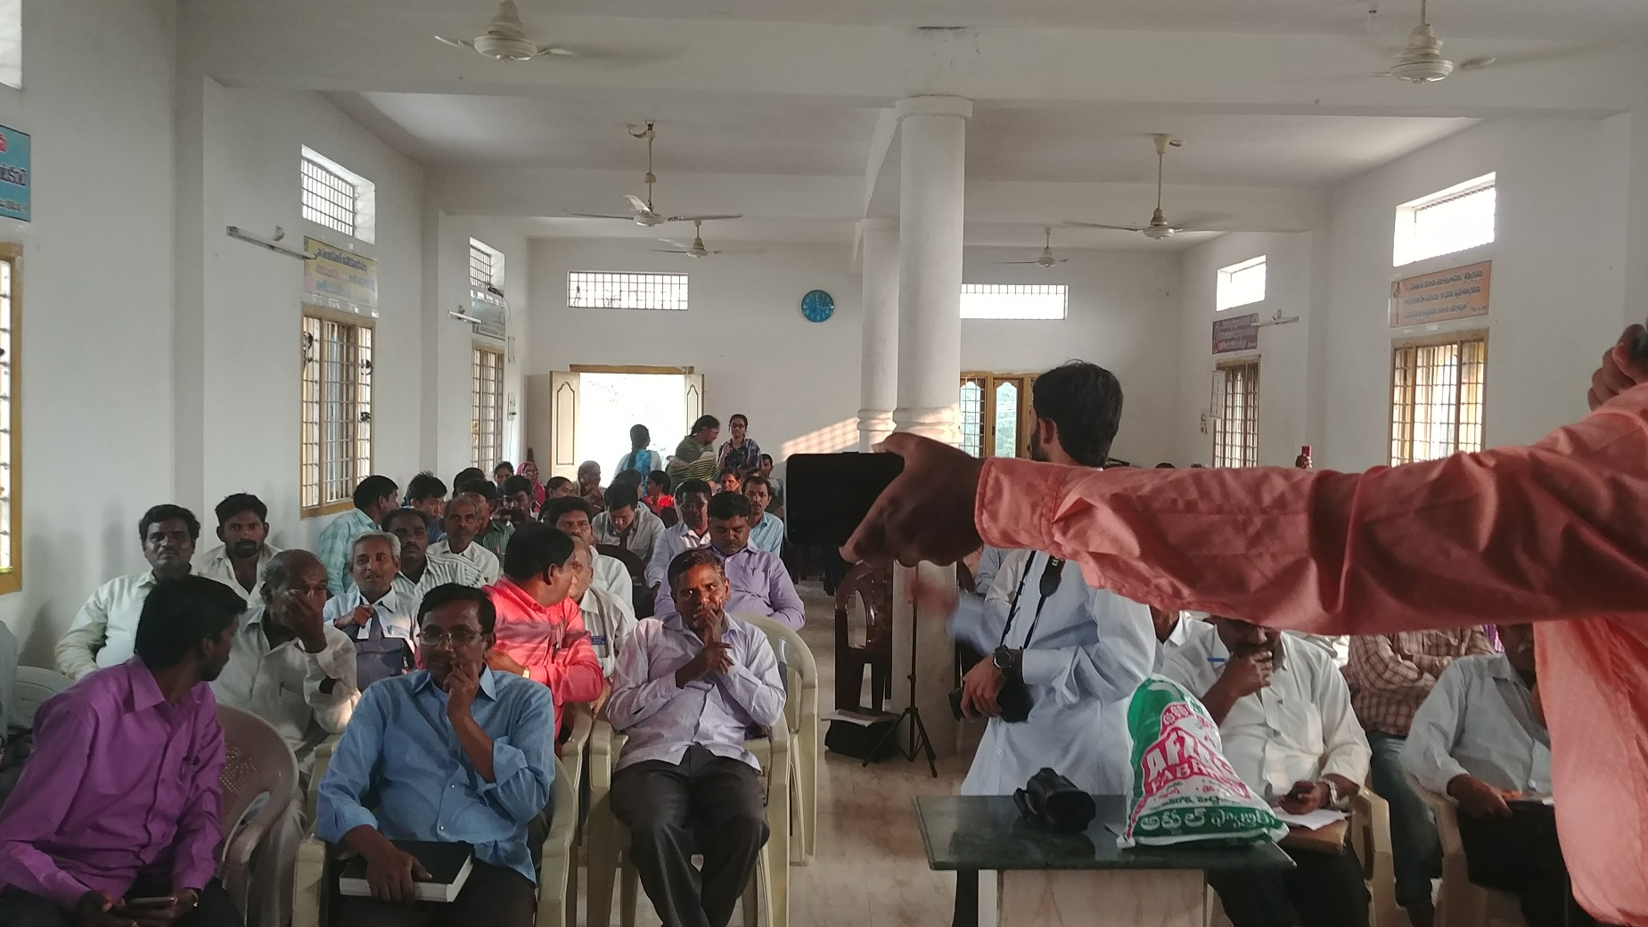

Slide 20
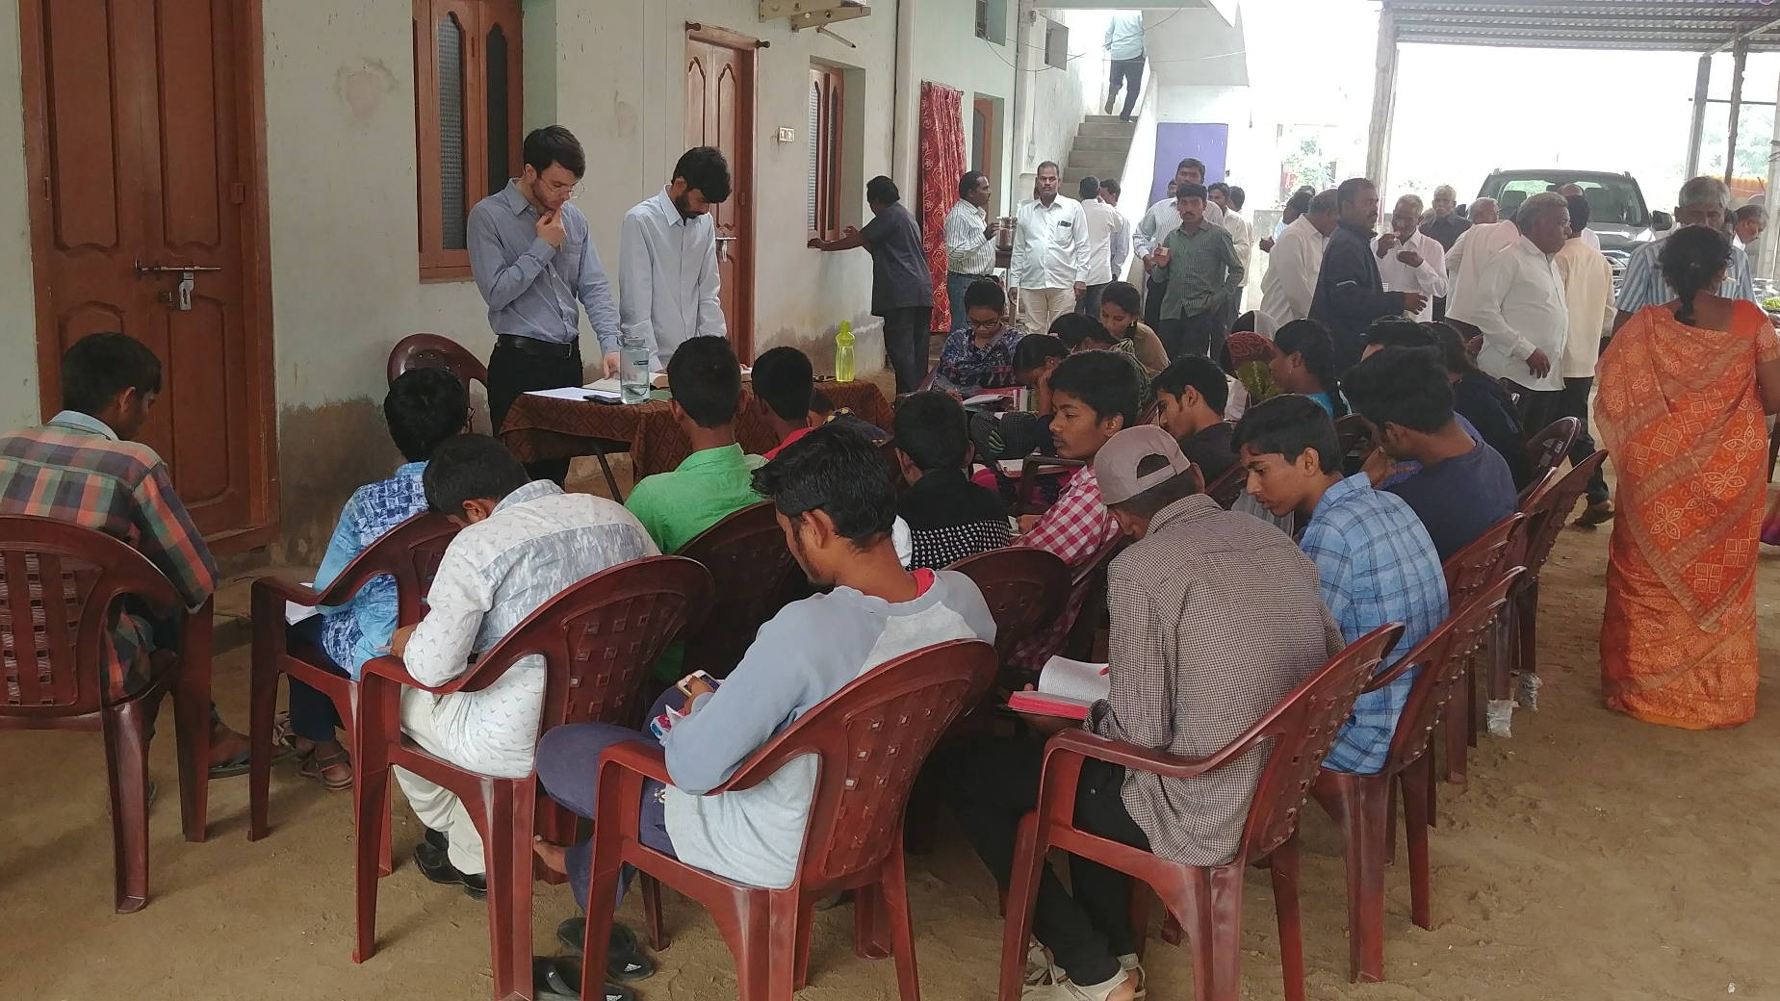
Seth and Alvaro taught youth

Slide 21
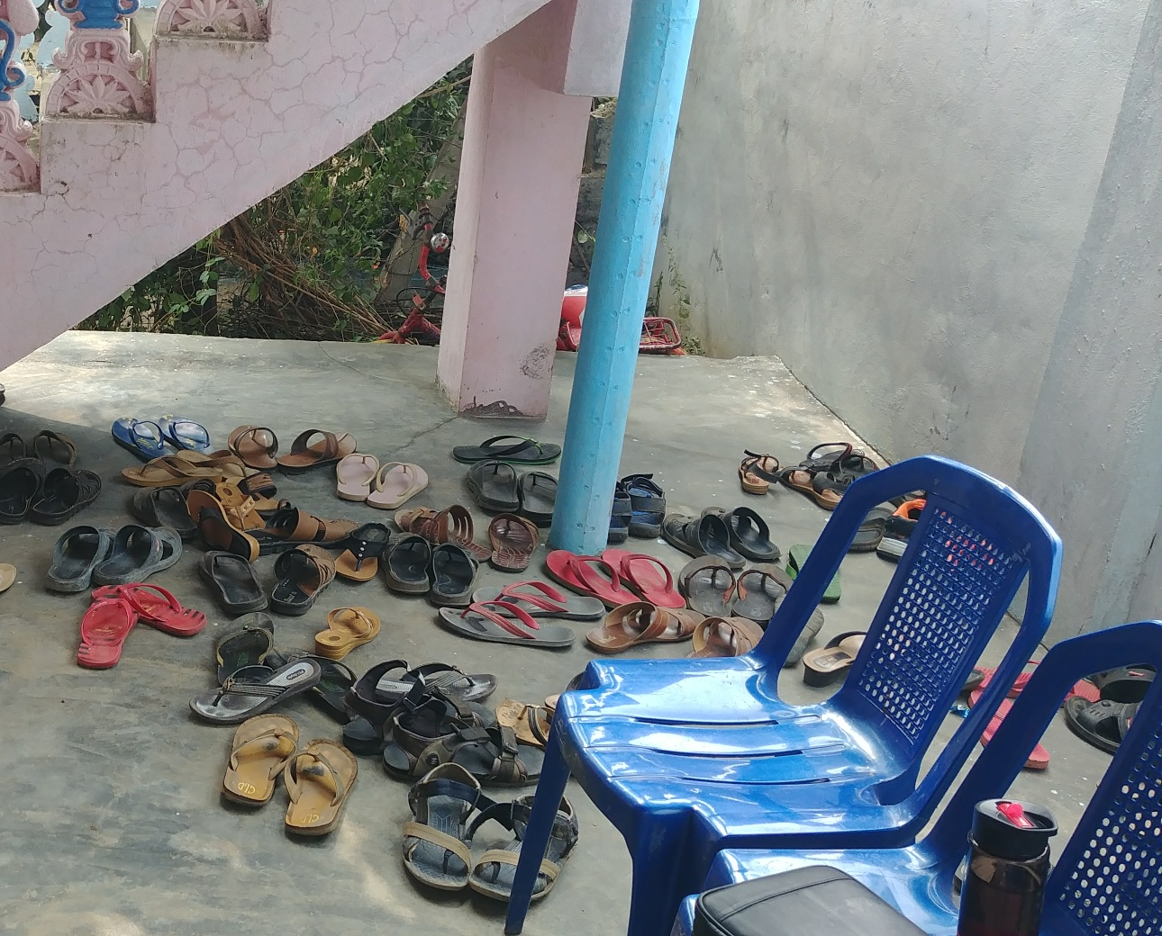
2nd Pastor’s Conference near Hyderabad
Beautiful Feet. Rom 10:15

Slide 22
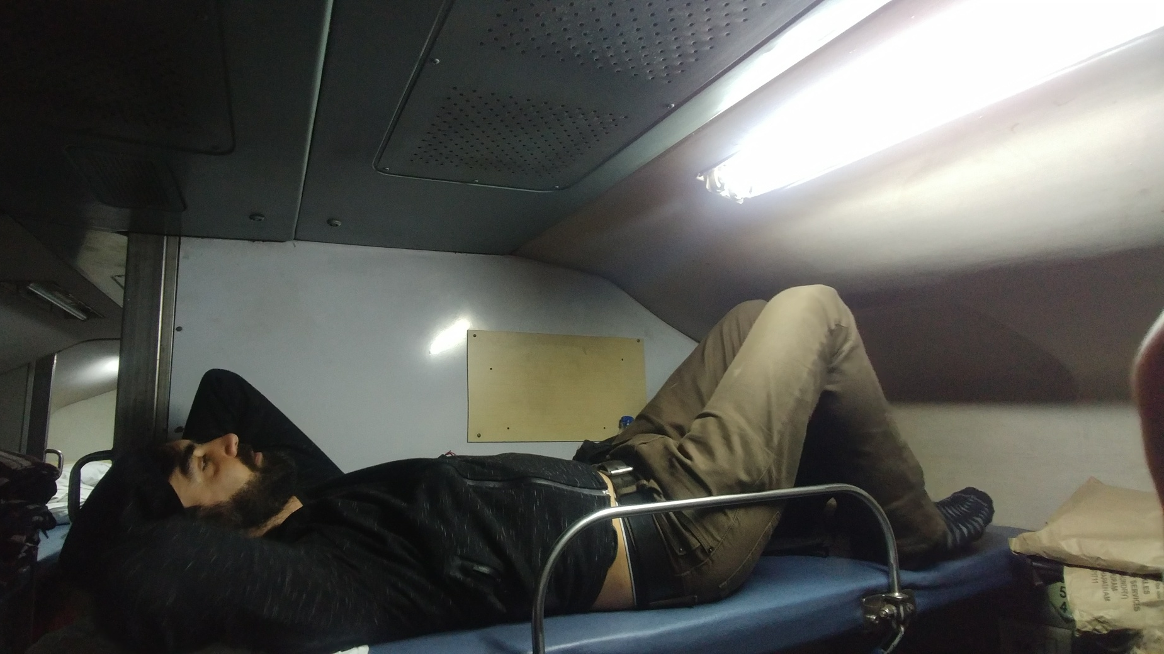
6 Hr Train Ride to Vizag

Slide 23
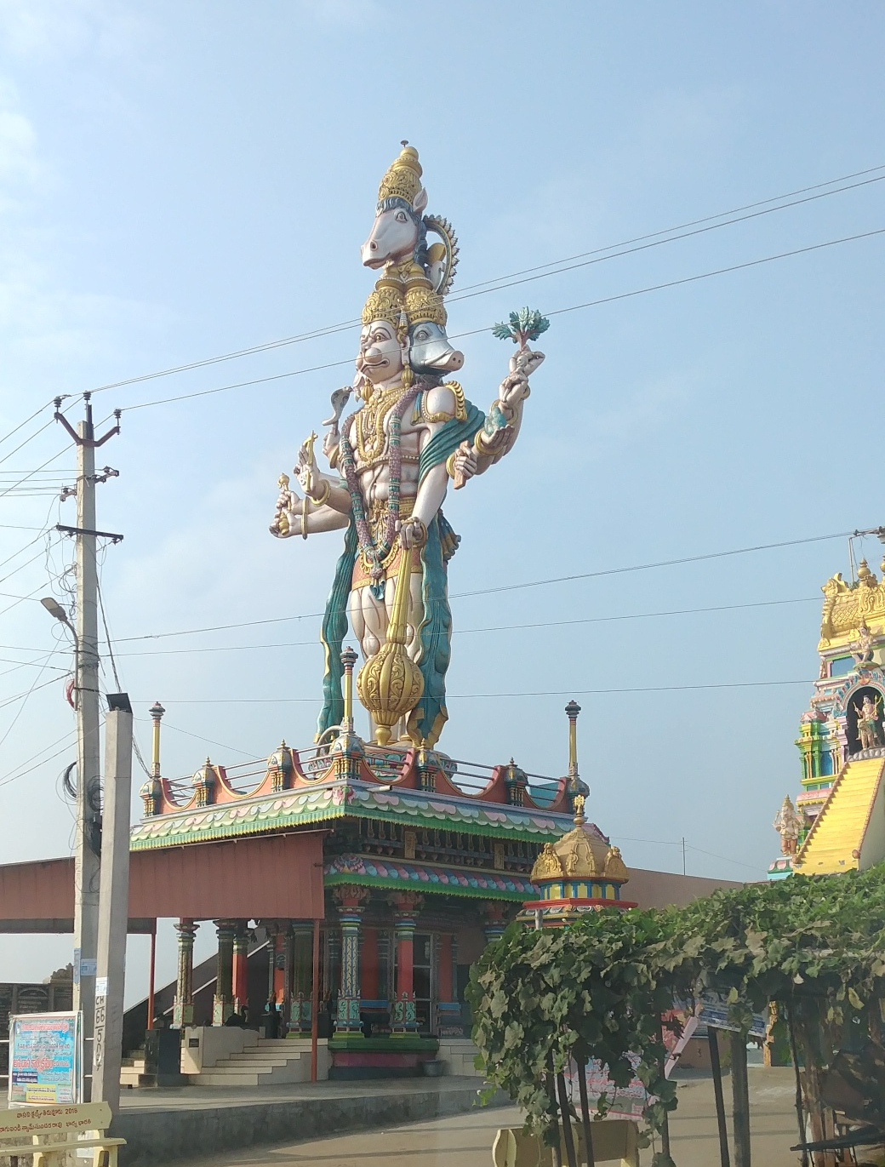
Roadside Idol:
Hanuman is the monkey god

Slide 24
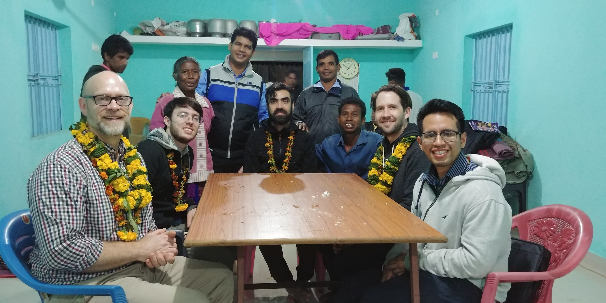
After service in one of the village churches birthed from Evangelism and Bible Study.

Slide 25
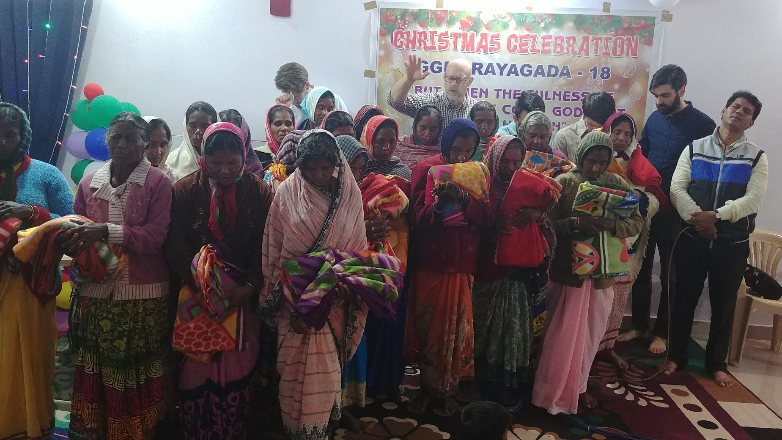
Widow Ministry in Rayagada at Pastor Pradeep’s church

Slide 26

2019 Missions trips
Your part?
12 planned trips

Slide 27


Slide 28

Boston
A growing Church FAMILY
MIDTOWN
Lee’s Summit
Fyffes
Kauai
Tampa
Costa Rica!
Vietnam

Slide 29

2019?
D1 snapshot
D2
Let’s trust God for all 200 of our qualified disciplers to be engaged making disciples.
100 people discipling
48 are currently available
to disciple
We are projecting 40 new disciplers from our current D2 training.
D1

Slide 30



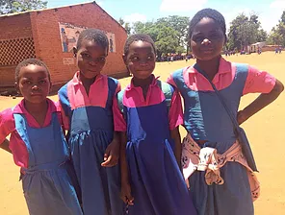

November 2019 – focus on the fatherless

Slide 31
motivation
Colossians 3:1-4 If ye then be risen with Christ, seek those things which are above, where Christ sitteth on the right hand of God. ² Set your affection on things above, not on things on the earth. ³ For ye are dead, and your life is hid with Christ in God. ⁴ When Christ, who is our life, shall appear, then shall ye also appear with him in glory.
Colossians 3:23-25 And whatsoever ye do, do it heartily, as to the Lord, and not unto men; ²⁴ Knowing that of the Lord ye shall receive the reward of the inheritance: for ye serve the Lord Christ. ²⁵ But he that doeth wrong shall receive for the wrong which he hath done: and there is no respect of persons.

Slide 32
0
Vision
Update
2
8
1

